Slide 1
Dynamic Programs
Adrian Streitz, Johannes Rank, Borys Levkovskiy

Slide 2
Prerequisites
Fundamental programming skills
Successful completion of the chapter Introduction to SAP Application Development
Recommended: Completion of the chapters Development of a first application, Basic concepts of ABAP programming, and Database access with ABAP programs

Slide 3
Agenda
Fundamentals
Dynpro at runtime
Dynpro layout
Developing Dynpros
Deploying and accessing Dynpros

Slide 4
I. Fundamentals General information about Dynpros
Dynpro = Dynamic program / Dialog program
Dynpros contain program logic combined with a Graphical User Interface (GUI)
A program can contain several Dynpro Screens
Every Dynpro has a unique ID in a program
Dynpros use their own instructions for coordinating runtime behavior → this is no ABAP
But: Dynpros call modules which are implemented in ABAP
Modules called by a Dynpro control the runtime behavior
Program
Dynpro 100
Dynpro 200
…
Dynpro 999

Slide 5
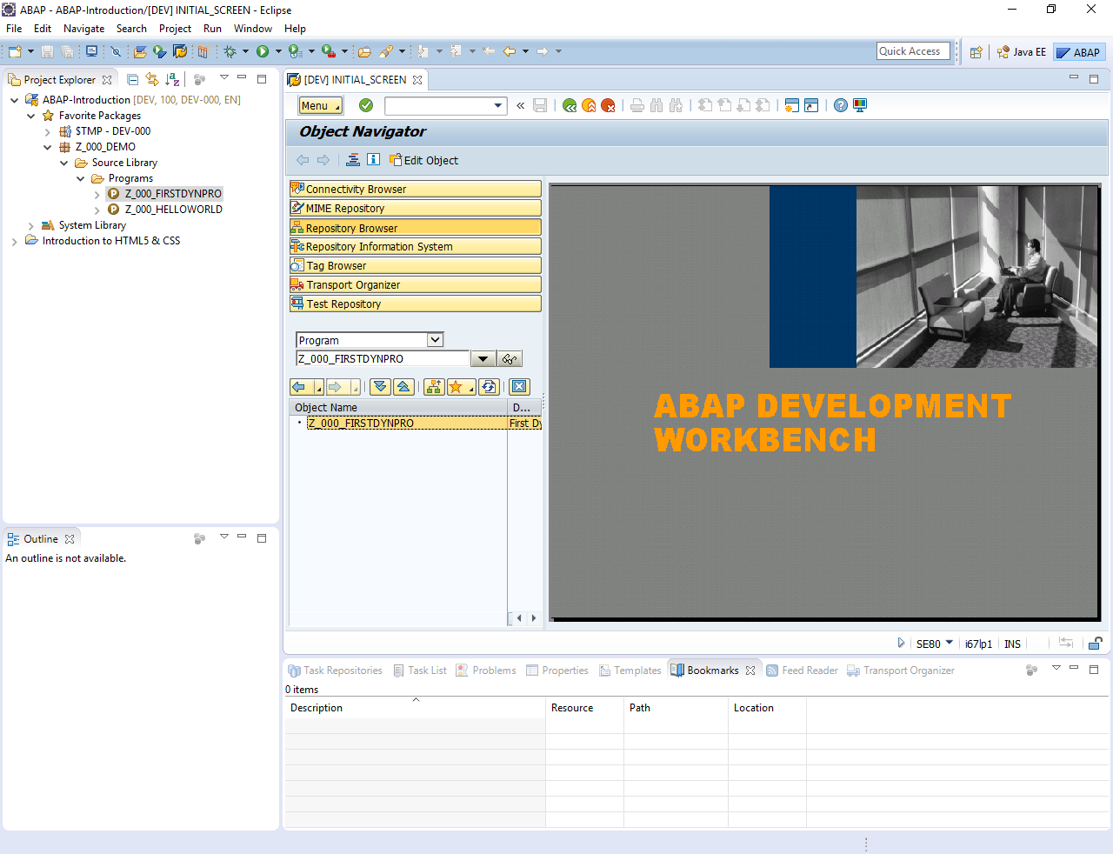
I. Fundamentals Dynpro development in Eclipse
Dynpros are specially designed for a usage within the traditional SAP GUI
The integrated SAP GUI in Eclipse can be used to create Dynpros
Dynpros call ABAP modules which can be implemented in Eclipse
Advantage: Coding in Eclipse is more comfortable compared with the traditional SAP GUI
All functions which are not available in Eclipse can be used via the integrated SAP GUI

Slide 6
I. Fundamentals Dynpro Structure
Transaction Code: Start Dynpro
Fields: data objects of a Dynpro
Screen: UI defined with the screepainter^{(*)}
Attributes: Settings for the screen
PBO: Process before output (before screen is displayed)
PAI: Process after Input (after the user input)
TA Code
Dynpro 100
Attributes
Dynpro Flow Logic
Fields
Screen
PBO
PAI
Global Data
PBO Modules
PAI Modules
ABAP
(*) The screenpainter is only available within sap gui for windows. With MAC you have to use the alphanumeric layout editor. Usage see https://help.sap.com/doc/saphelp_nw73ehp1/7.31.19/en-US/d1/80231e454211d189710000e8322d00/content.htm?no_cache=true

Slide 7
II. Dynpro at runtime Dynpro runtime modules
Dynpro Flow Logic
TOP include
Contains data declaration
Considered for all syntax checks
Always integrated for compiler
No operational code
Process before output (PBO) 100
Dynpro
100
Process after input (PAI) 100
Commit
User input
(Function Code)
Process before output (PBO) 200
Dynpro
200
Process after input (PAI) 200
User input
(Function Code)

Slide 8


II. Dynpro at runtime Flow Logic
Dynpro Flow Logic
Coordinates Runtime behavior
PROCESS BEFORE OUTPUT
Executed before sending the Dynpro screen
Used to prepare the screen, e.g. set default values
PROCESS AFTER INPUT
Executed every time a user interaction triggers a function code / OK code
Example:
PROCESS ON HELP-REQUEST
Optional
Triggered when user selects the info help F1
PROCESS ON VALUE-REQUEST
Optional
Triggered when user selects the input help F4
Code Example:

Slide 9
III. Dynpro at runtime Flow Logic Statements
Dynpro Flow Logic
MODULE:
Call an ABAP Module
FIELD:
Dynpro data object
CHAIN / ENDCHAIN
Dynpro data object
Related to global data object of the ABAP program
LOOP / ENDLOOP:
Loop over Dynpro controls (e.g. buttons, input fields, …) -> e.g. change properties in PBO
CALL SUBSCREEN:
Include a subscreen Dynpro

Slide 10
III. Dynpro layout GUI elements
Screen
Dynpros contain user interfaces which may contain the following elements:
Text
Input fields
Check boxes
Radio buttons
Buttons
Tabs
Frame Subscreens
Table Controls
Custom Controls
Element’s attributes may be changed during runtime (e.g. button text)

Slide 11
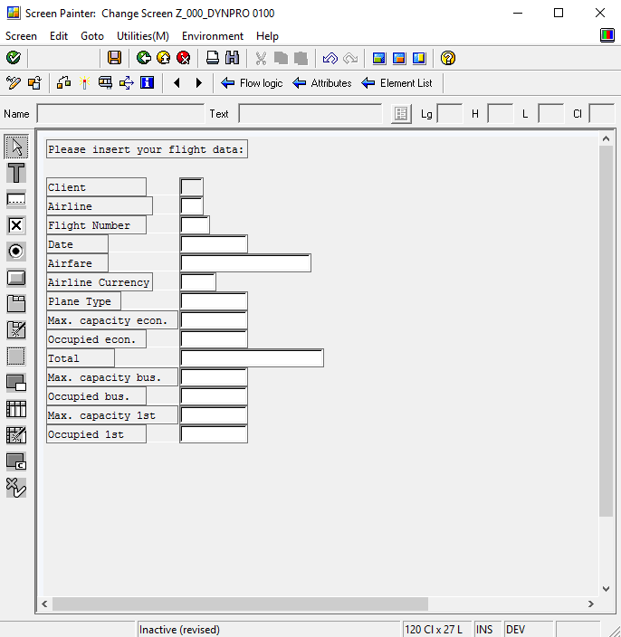
III. Dynpro layout Graphical Screen Painter
Screen
Graphical Screen Painter is an external program which is integrated into the SAP GUI
Can be used to draw a new Dynpro
Elements can be referenced to the data dictionary (e.g. tables)
Several views are available:
Main view: contains the main elements of your Dynpro
Element list: contains all element’s attributes
Dictionary: contains elements from the data dictionary which may be inserted into your Dynpro
Attributes: contains attributes of one element from your Dynpro

Slide 12
III. Dynpro layout Title and status bar
Screen
For each Dynpro you may define a title and status bar
Title defines the title of the Dynpro (Example: Connection details)
Status bar defines the menu and the flexible and fixed tool bar (Examples: Save, Back, Exit, …)
Status bar defines function code / return status (OK_CODE) of elements
Based on the OK_CODE you define further actions (e.g save data, leave application, back to last screen …)
Status
Title

Slide 13
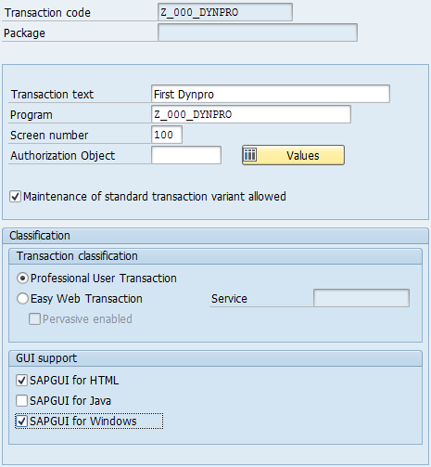
III. Dynpro layout Transaction codes
TA Code
Transaction codes serve to directly access programs
They can be used like the standard SAP transactions
SAP users can be given or denied rights to the transactions
They are defined based on a Dynpro program and a starting screen
The starting screen of a program is called when the transaction code is executed (e.g. SE80 calls the starting screen of the ABAP Workbench)

Slide 14
III. Dynpro layout Dynpro attributes
Attributes
Dynpro attributes
Administration
Type
Size
Order
Settings
Program
Dynpro No.
Short text
Group
Changes
Generation
Status
Original language
Package
Development class
Normal
Subscreen
Selection Dynpro
Dialog screen
Static
Dynamic
Following Dynpro
Runtime compression
Context menu
Cursor position
Hold data

Slide 15
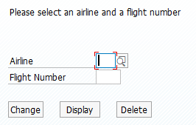
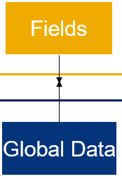
IV. Data management Dynpro Fields
Fields
Fields are the data objects of a dynpro, e.g. input field
In Dynpro no explicit data declaration is possible (“you can not create a local variable”)
A Field is either related to the ABAP Dictionary or a global data object in the ABAP program
A Field is a data handler to pass the information from the ABAP layer into the Dynpro and back
After the PBO phase the data from the global ABAP data object is sent to the related field
After PAI the data from the field is sent back to the global data object
Screen 0100
Field spfli-connid
Screen 0100
Value of Spfli-connid
PBO
PAI
ABAP
Value of Spfli-connid

Slide 16
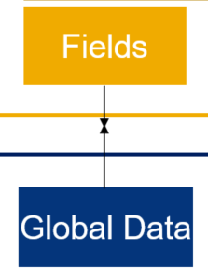
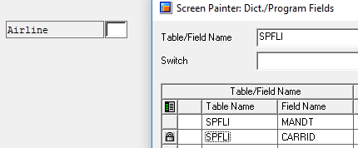
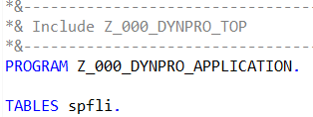
IV. Data management Tables Statement
Fields
If a Dynpro Field refers to a structure of the ABAP dictionary (see SPFLI in next excercise) …
You have to explicitly define the structure via the Tables statement in the Dynpro
Otherwise the Dynpro Field and ABAP program are not connected => No data handling
Example:
Screen field refers to database table SPFLI
You have to declare SPFLI in the Top Include of your Dynpro application

Slide 17
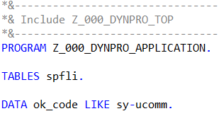
IV. Data management Top Include
Fields
Special Include file that contains all global declarations
No operational code allowed
In contrast to a regular include file, the top include is always considered by the syntax check and compiler
In the context of Dynpro applications, the top include encapsulates all global variables, e.g.
TABLES
OK_CODE
Accessible by every Dynpro in the program

Slide 18
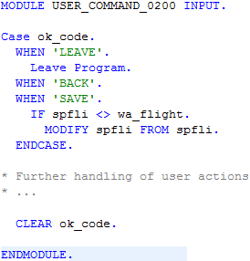
IV. Data management OK Code
PAI
Special dynpro field that is implicitly defined when creating a new Dynpro
Manages the return code of the Dynpro
1. Set the return code, based on the buttons in the status bar
2. Handle ok_code in PAI section

Slide 19
Now you know the fundamentals of a Dynamic Program (Dynpro).
To consolidate your knowledge, you can do tasks 1 and 2 of the Dynpro exercise.

Slide 20
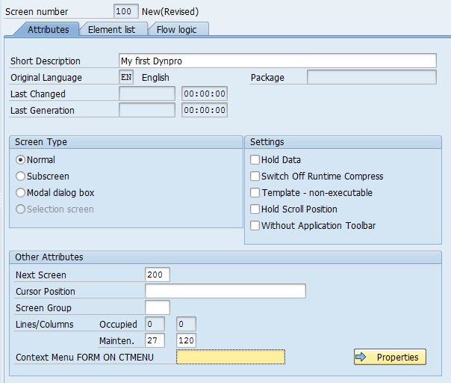
IV. Developing Dynpros Step 1: Determine Dynpro attributes
The following Dynpro attributes have to be determined:
Screen number (3 digits)
Short Description
Dynpro Type (Normal, Subscreen, …)
Next Screen
The element list contains all attributes which are contained in the Dynpro
The flow logic contains the program code for the PBO and PAI modules which control the Dynpro at runtime

Slide 21
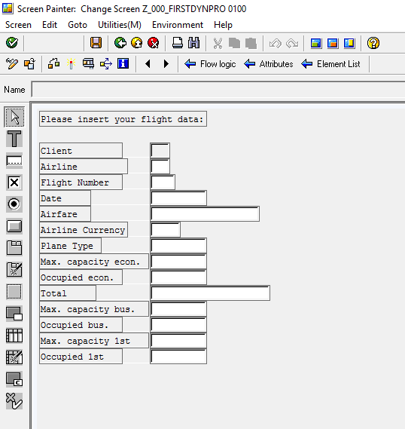
IV. Developing Dynpros Step 2: Create Dynpro layout
Use the Graphical Screen Painter to create the elements within your Dynpro
Maintain attributes for your Dynpro elements (data type, field size,…)
Assign unique names to your GUI elements
Connect input fields and tables to dictionary objects if necessary
Assign a function code to buttons and other elements which create events
Assign the OK_CODE to the Dynpro

Slide 22
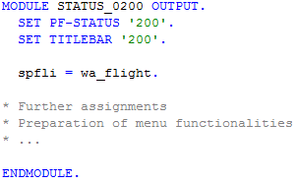
IV. Developing Dynpros Step 3: Code the processing logic
ABAP Modules
Dynpro Flow Logic
A PBO module usually defines title and status bar
PBO modules are called before the Dynpro is shown to the user
You can also assign database values to Dynpro elements
The flow logic defines PBO and PAI modules
Special user events can be handled
PAI modules are called after the user confirmed an input
PAI modules usually handle the ok_code
Database operations can be triggered

Slide 23
Now you know the complete development process of a Dynamic Program (Dynpro).
To consolidate your knowledge, you can do task 1, 2, 3 and 4 of the Dynpro exercise.

Slide 24
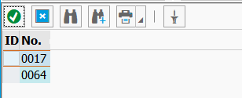


V. Dynpro Usability Input Help
Input helps (F4) support the user when inserting values to fields
Avoid misspelling
Avoid invalid input
Trigger the input help in the “PROCESS ON VALUE-REQUEST” section
Implement module to return a value table
Self programmed input help not always necessary
Data dictionary based fields mostly provide usually have a default input help

Slide 25
Now you know the complete development process of a Dynamic Program (Dynpro).
To consolidate your knowledge, you can do task 5 of the Dynpro exercise.

Slide 26
Check your knowledge

Slide 27
Check your knowledge
Why is it preferable to use Eclipse for developing Dynpros instead of the traditional SAP GUI?
Which steps at developing Dynpros can be done in Eclipse without the integrated SAP GUI?
□ Determine Dynpro attributes
□ Create Dynpro layout
□ Coding PBO and PAI modules
Which functionalities are usually contained within the PBO and PAI modules?
Where do you define by default which Dynpro is called after the user input was confirmed?
□ Transaction code
□ Dynpro attributes
□ PAI module

Slide 28
Solution

Slide 29
Solution
Why is it preferable to use Eclipse for developing Dynpros instead of the traditional SAP GUI?
See section Fundamentals
Which steps at developing Dynpros can be done in Eclipse without the integrated SAP GUI?
□ Determine Dynpro attributes
□ Create Dynpro layout
☒ Coding PBO and PAI modules
Which functionalities are usually contained within the PBO and PAI modules?
See section Developing Dynpros
Where do you define by default which Dynpro is called after the user input was confirmed?
□ Transaction code
☒ Dynpro attributes (see chapter Developing Dynpros)
□ PAI module

